Slide 1

CS584 Project Presentation
Comparing stock trend prediction with multiple methods
— PeiGuo
— HaoLiu

Slide 2
Project Introduction
Challenges and harvest
Theory and algorithm
Data collection and calculation
Test results
Conclusion and future work

Slide 3
Project Introduction
— Hope to use data other than the prices in the financial market, as well as financial knowledge
and combine machine learning to try to predict the price trend
— Using a variety of algorithms to predicted the stock future trend as a classification problem
— Trying to find the difference and reason between different algorithms
Notes:
— 希望运用金融市场的价格以外的数据、以及金融知识，结合机器学习，试图对价格趋势作预判
— 运用多种算法，对股票未来趋势当作一个分类问题，进行试验
— 试图寻找不同算法之间的差异和原因

Slide 4
Challenges and harvest
Challenges
— Difficulty of data getting,especially basic financial data
— Difficulty of data cleaning,including many abnormal problems,
such as different stock will have different closing dates, restoration price, etc
—Optimization process of various algorithms
Harvest
— There is a lot of noise in the stock market, so it is difficult to use price data for prediction,
and more information outside the market should be explored as features
— Further familiar with the use and optimization process of various algorithms
— …
Notes:
— 数据获取的难度，尤其是基本面的一些金融数据
— 数据的清洗难度，较多异常问题，比如个别股票停盘，复权处理等
— 各类方法等优化过程
— 股票市场噪音很多，单纯的使用价格数据作预测很难，应该更多挖掘市场以外的信息作为特征— 进一步熟悉了各类算法的使用和调试过程
— 进一步熟悉了各类算法的使用和调试过程
— ….

Slide 5
Theory and algorithm
Algorithm
— Fully Connected Neural Network
— BayesianMethod
— LSTM
— MultiFactor(Linear)

Slide 6
Theory and algorithm
Theory

Slide 7
Data collection and calculation
Data
— stock price data
stock_code | trade_date | open | high | low | close | change | pct_chg | vol | amount
000001.SZ | 20210423 | 23.32 | 23.65 | 23.07 | 22.98 | 0.3099 | 1.349 | 823230.15 | 1920413.502
—Financial data, market data
stock_code | trade_date | turnover_rate | turnover_rate_f | volume_ratio | pe | pe_ttm | pb | ps | ps_ttm
000001.SZ | 20210423 | 0.4242 | 0.9571 | 0.81 | 15.6237 | 14.8127 | 1.4932 | 2.9436 | 2.8714
stock_code | trade_date | dv_ratio | dv_ttm | total_share | float_share | free_share | total_mv | circ_mv
000001.SZ | 20210423 | 0.936 | 0.936 | 1940591.8198 | 1940575.4475 | 860111.3751 | 45196383.4831 | 45196002.1723

Slide 8
Data collection and calculation
Data calculation
— Return data : cumulative yield per stock before n day and after n day
— MACD、KDJ、MA price calculation index etc
— Filtering and processing of each stock's off day
— A total of 4000+ stocks data were collected from the opening date
Notes:
— 每日前后+T日收益率的计算，return
— MACD、kdj、MA等计算和验证
— 停牌数据 过滤、处理
— 总共收集了4000+只股票 从开盘至今的数据

Slide 9
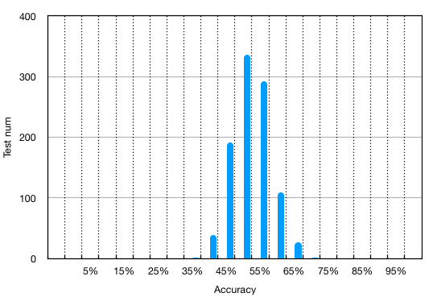
Test results
Results
 | max Accuracy | min Accuracy | avg Accuracy
ANN | 62.5% | 37.5% | 50%
Bayes | 60% | 37.5% | 53.17%
Linear
LSTM
predict accuracy distribution of 1000 stocks

Slide 10
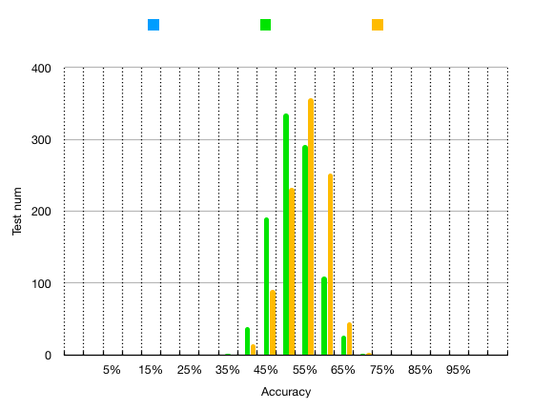
Test results
Distribution
—The accuracy of almost all methods
in most stocks is only about 50%
— Although the average accuracy of prediction
is similar, there are some methods with
more concentrated accuracy distribution
Notes:
— 谁比谁更好一点
— 谁更集中
— 大部分都维持在50%上下随机波动

Slide 11
Conclusion and future work
— It is very difficult to judge the future price or trend of the stock only by the data in the market
— The main reasons for the difficulties should be as follows:
According to Ornstein Uhlenbeck process,stock is the superposition of mean regression and
Brownian motion, which leads to the noise of market data.
The internal law of the market is not stable in different time dimensions.
— We should consider more market factors, such as financial information, news information,
search information and so on. External features are less noisy and more valuable
Notes:
— 纯粹靠市场内数据，希望对股票的未来价格或者趋势作判断是很困难的
— 困难的原因应该主要来自于：
股票是一个 价值和布朗运动的叠加，导致的本身市场内数据的噪音很大
市场的内在规律在不同的时间维度下并不稳定
— 应该考虑更多市场的因素、比如财务信息、新闻信息、搜索信息等，外部特征噪音更小更有价值，但也可能有滞后性

Slide 12
THANKS

